Slide 1



Fuel Efficiency through Transmission Design: Hoax or Reality?
Paul J. Motes

Slide 2
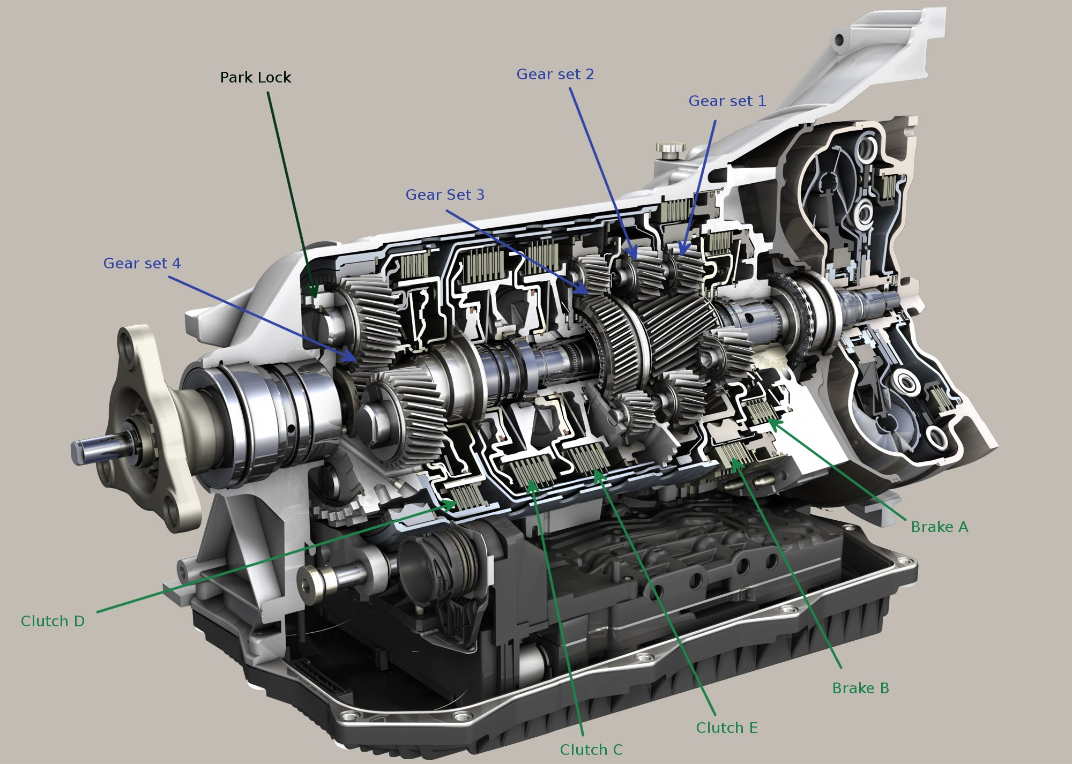
Transmission Design, Part 1:
8 speed transmission design in cars like BMW, Ford, Dodge, Chevrolet, Alfa Romeo, and even Rolls Royce.

Slide 3
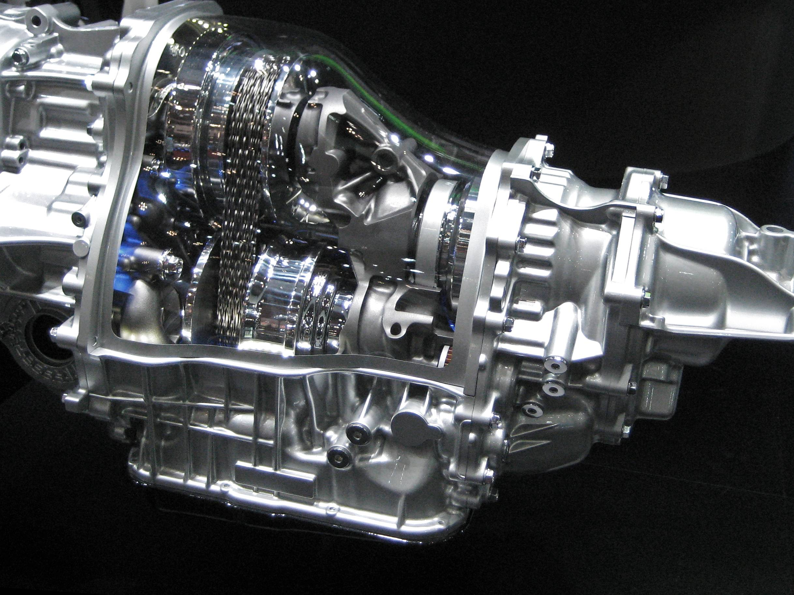
Transmission Design, Part 2:
CVT Transmission
Notes:
CVT transmissions were used may centuries ago In tractors and different equipment.

Slide 4
Research Question?
To what extent do the total number of gears in the transmission have on fuel economy (FE) for vehicles driven in the United States that were produced from 2020-2021?

Slide 5
Project Scope
Analyze fuel economy (FE) data from EPA testing
2020 – 2021 Vehicles
Limited by our research question
Transmission Design
Fuel Economy (FE)

Slide 6
Business Need
Legend’s Business need?
2024 Alanty Model
Transmission design improves FE?
Current Transmission Design for Alanty
6 speed automatic Transmission, Average 29.5 mpg
Change from a 6-speed transmission to another transmission design?
2020-2021 EPA: Average FE was 35.45 mpg.

Slide 7
Research Hypothesis
Alternative Hypothesis:
The total number of gears in the transmission has an impact on fuel economy in vehicles driven between 2020 and 2021 in the United States.
Null Hypothesis:
The total number of gears in the transmission have a neutral impact on fuel economy in vehicles driven between 2020 and 2021 in the United States.

Slide 8
Constraints of Data Analysis
Data to be used?
Unnecessary columns?
How to deal with not a number (NaN)?
Fuel type limitation?
Outlier values?
What is the key focus?
Transmission Design and FE

Slide 9
Key Terms
Number [of] Gears
Design with respect to number of gears, goes from 1 to 10 speeds.
Adjusted Fuel Economy
Numerical value of fuel economy for each vehicle tested.
Test Fuel Type Description
Fuel type: either gasoline, diesel, or electric.
Partial Hybrid (engine combined with battery power)
Test Category
Type of vehicle test used by the EPA.

Slide 10
Jupyter Notebook
Show Jupyter Notebook Window:
Functional parts of Python code.
Cover key visualizations.

Slide 11
Summary of Findings, Part 1:
Transmissions:
8 speed transmission won the popularity contest!
6 speed and 8 speed have outliers which affect the average.
Diesels use 6, 8 or 10 speeds.
Gasoline models vary.

Slide 12
Summary of Findings, Part 2:
Fuel Economy:
FE generally was between 10 and 50 mpg
Highest Average FE
1 speed – CVT transmission (Sample size 1374)
5 speed transmission (Sample size was only 60)
6 speed transmission (Sample size was 1474)
8 speed transmission (most stable FE, size was 2636)

Slide 13
Summary of Findings, Part 3:
Modeling
Correlation – Negative
Linear Regression, OLS - p-value = 0.0
One-way ANOVA (Kruskal Wallis) - p-value = 0.0
Polynomial regression – 4th order equation
Method | P-Value | Alpha | P-value < Alpha | R squared
Linear Regression (sklearn ML modeling) | 0.0 | 0.05 | True | 0.219
OLS (stats module) | 0.0 | 0.05 | True | 0.219
Kruskal-Wallis (ANOVA) | 0.0 | 0.05 | True | N/A
4th order polynomial | N/A | 0.05 | N/A | 0.230

Slide 14
Transmission Design: Hoax or Reality?
Back to Research Question?
Based on findings, p-value = 0.0, and slope coefficient is negative.
Therefore, Reject Null Hypothesis.
Accept Alternative Hypothesis.
Meaning?
Transmission design does impact FE.
1 speed 45 mpg, 6 speed 33.5mpg, 8 speed 30.2 mpg
Hoax or Reality?

Slide 15
Transmission Design: Hoax or Reality?
Back to Legend’s business needs?
1 speed CVT Transmission
Regulated FE standards?
Further Research : Improve vehicle sales and customer satisfaction?

Slide 16

May the “Gears” be with you !

